Slide 1

a
Flocknote process to create new member profiles and update existing profiles.

Slide 2
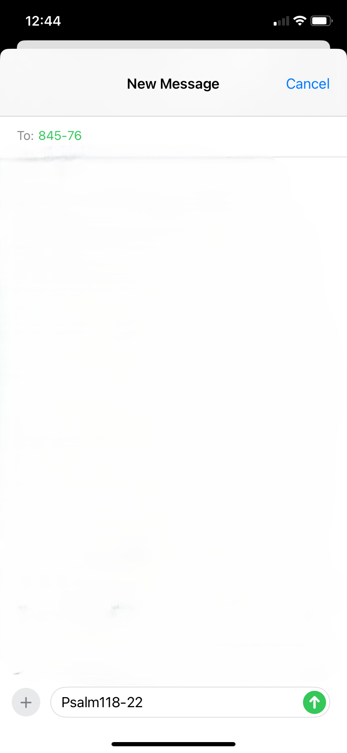
Text to 84576 the Keyword Psalm118-22

Slide 3
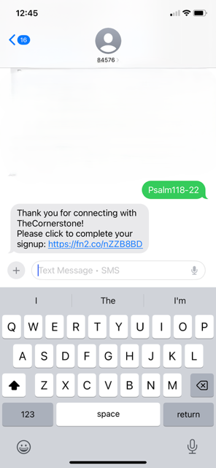
Click on the link here.

Slide 4
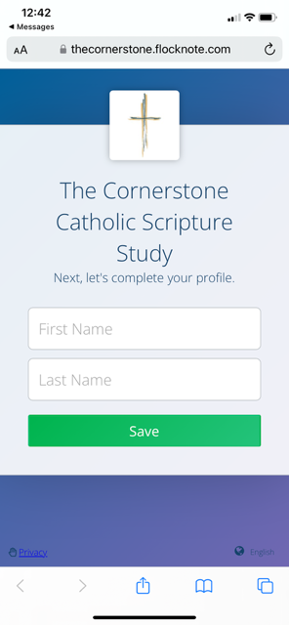
Enter First Name and Last Name in the boxes provided.

Slide 5
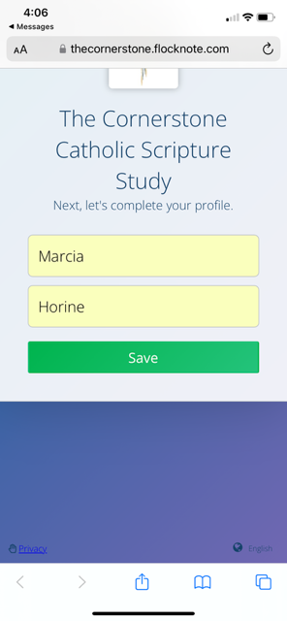
Click Save

Slide 6
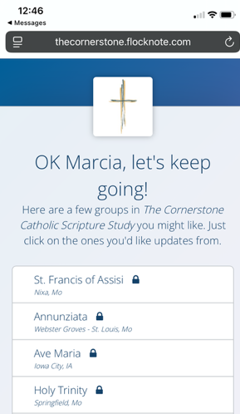
All the Branches established currently are listed. Check the branch you are joining if a new member or scroll down to confirm that you a have check mark next to the branch you are currently a member of.

Slide 7
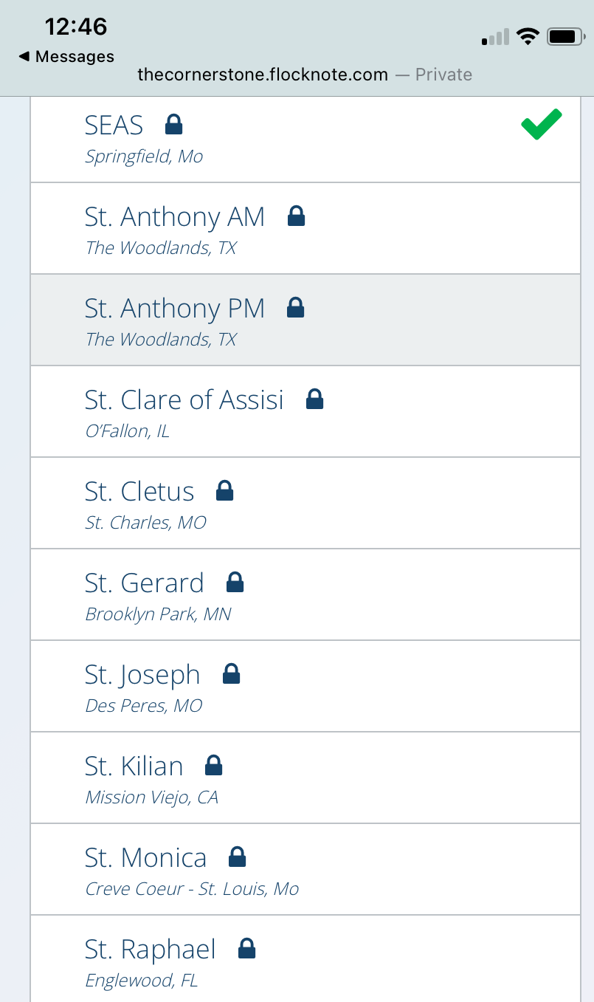
After confirming your branch is checked, click on the Next button.

Slide 8
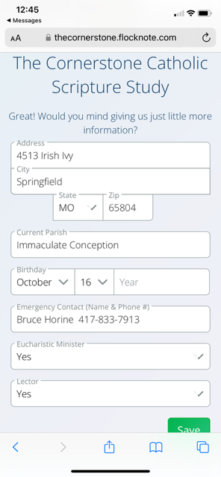
You will then be prompted to fill out additional fields in your profile. Scroll down to make sure you get all the fields completed. When finished click on the Save button.

Slide 9
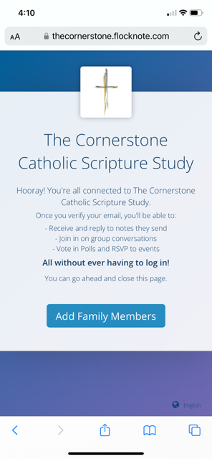
This is the last screen you will see on your phone to let you know your profile updates are complete.

Slide 10

This Text-to-Join process can be used by any member of The Cornerstone to update their profile information at their convenience. This is an easy way for
Branch Coordinators and Facilitators to maintain an accurate and updated database of their membership.

